Slide 1
Springboard DATA SCIENCE Bootcamp
Capstone 2 – Telco Customer Churn Prediction
Vidya Sadhanala

Slide 2
CONTENTS
Objective | Machine Learning
Problem | Cross Validation
Outcome | Hyper-parameter tuning
Dataset | Conclusion
Data Wrangling
Explanatory data analysis
Data-Preprocessing

Slide 3
Objective
The objective is to predict customer churn behavior for Telco which is a telecommunications service provider so they can better retain their customers by analyzing all relevant customer data and develop focused customer retention programs.

Slide 4
UNDERSTANDING Churn
Contractual Churn
Non Contractual Churn
Churn
When an existing customer stops doing business with a company or end the relationship with company
Typically happens when customers explicitly cancel service or subscription.
Examples: Internet Service, Streaming subscription
Customers does not have any contractual obligation but stops purchasing.
Examples: Online shopping, grocery shopping

Slide 5
Problem
?
Understand when a customer is going to churn.

Slide 6
Desired Outcome
01
02
03
Analyze and Understand
Build a Churn Model
Predict Customer Churn
Explanatory data analysis helps understand churned customer behavior and patterns compared to non-churned customers
Using machine learning and with insights about data we will fit various models and evaluate.
Finally, we will select the best model that predicts the customer churn probabilities and use it to prevent churn in the future

Slide 7
Dataset
Company Services
Customer Demographics
Customer Account
Churned Customer
Services that each customer has signed up for – phone, multiple lines, internet, online security, online backup, device protection, tech support, and streaming TV and movies
Customer’s gender, age range, and if they have partners and dependents
How long they’ve been a customer, contract, payment method, paperless billing, monthly charges, and total charges
Customers who left within the last month – the column is called Churn

Slide 8
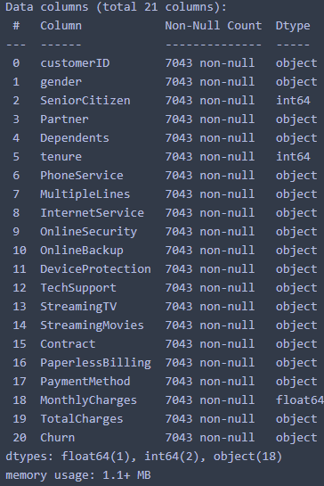
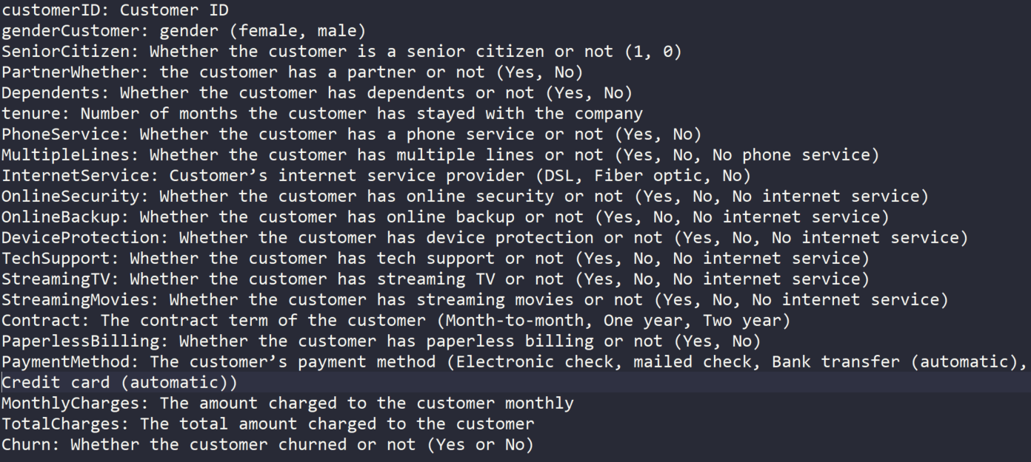
Dataset Preview
Data Types
Data Definitions

Slide 9



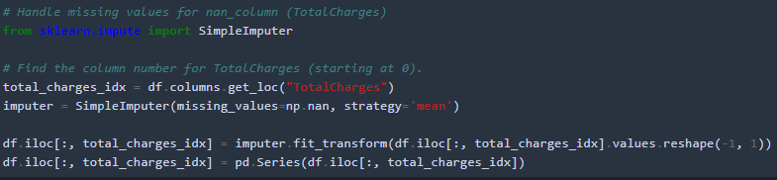
Data Wrangling
Total Charges variable is an object data type so had to convert it into a numerical data type for analysis
Converted Churn variable to numerical data type for analysis
Total Charges variable contains missing or null values, so imputing them with means and used SimpleImputer from Sklearn.impute

Slide 10
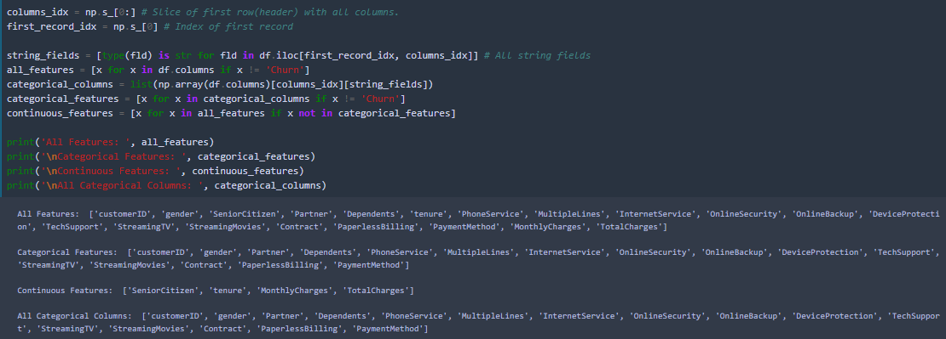
Data Wrangling

Slide 11
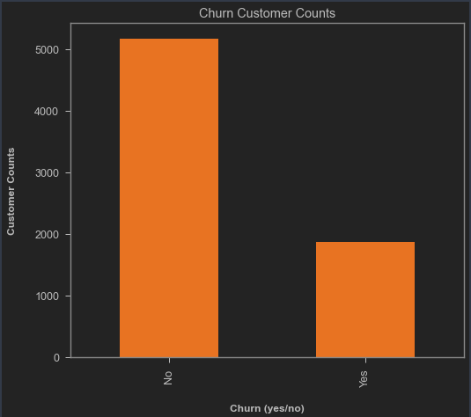
EDA (Explanatory Data Analysis)
Churn Variable
No 5174
Yes 1869
Name: Churn, dtype: int64
Roughly a quarter of the customers have churned in this data set!

Slide 12
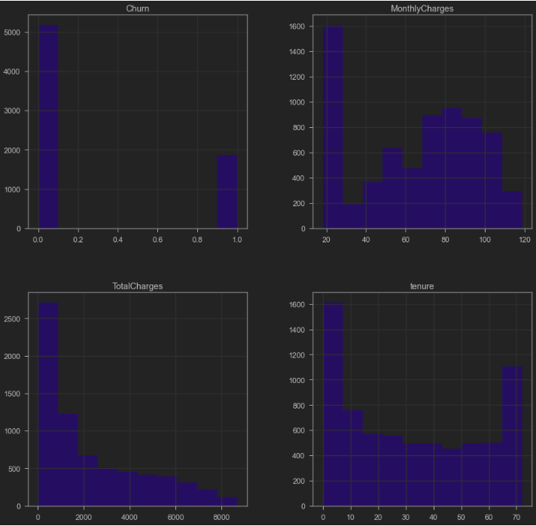
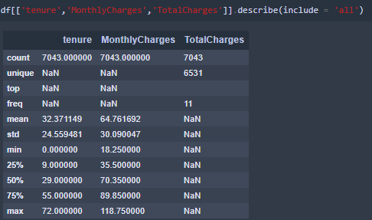
EDA (Explanatory Data Analysis)
We see that Tenure ranges from 0 (new customer) to 6 years, Monthly charges range from $18 to $118, etc.
Monthly Charges seems to be roughly normal distribution and Tenure Distribution seems to be high at the ends, so a portion of the customers have either had lowest and highest tenure periods.

Slide 13
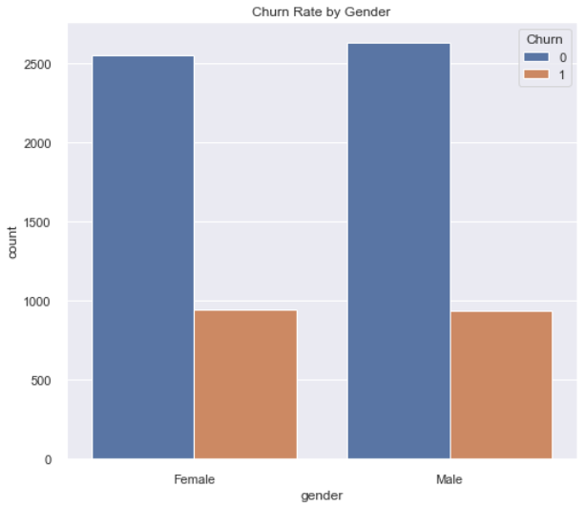
EDA – Categorical Variables
Gender
Female churn is little higher, but not that big of difference
Churn
gender
Female 0.269209
Male 0.261603

Slide 14
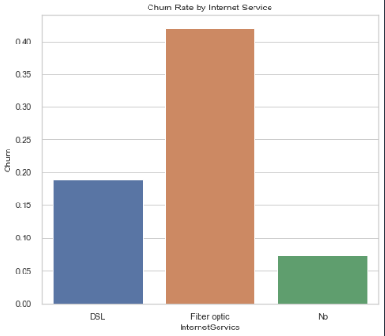
EDA - Categorical Variables
InternetService
Fiber Optic customers are churning at a higher rate
Churn
InternetService
DSL 0.189591
Fiber optic 0.418928
No 0.074050

Slide 15
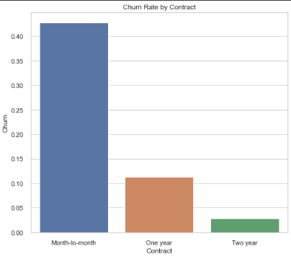
EDA – Categorical Variables
Contract
Month to Month subscribers are churning at a higher rate
Churn
Contract
Month-to-month 0.427097
One year 0.112695
Two year 0.028319

Slide 16
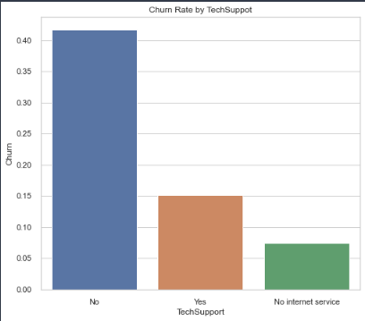
EDA – Categorical Variables
TechSupport
Customers who did not use Tech Support are churning at a higher rate
Churn
TechSupport
No 0.416355
No internet service 0.074050
Yes 0.151663

Slide 17
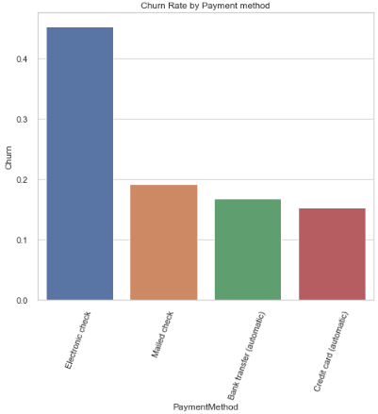
EDA – Categorical Variables
Payment Method
Customers who use checks as payment method are churning at higher rate
Churn
PaymentMethod
Bank transfer (automatic) 0.167098
Credit card (automatic) 0.152431
Electronic check 0.452854
Mailed check 0.191067

Slide 18
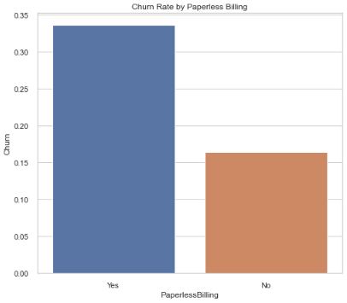
EDA – Categorical Variables
Paperless Billing
Customers who are on paperless billing are churning at higher rate.
Churn
PaperlessBilling
No 0.163301
Yes 0.335651

Slide 19
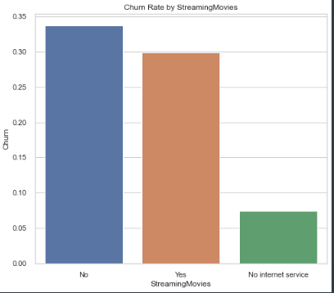
EDA – Categorical Variables
StreamingMovies
Customers who not steaming movies subscribers are churning at higher rate
Churn
StreamingMovies
No 0.336804
No internet service 0.074050
Yes 0.299414

Slide 20
EDA – Categorical Variables
StreamingTV
Customers who not steaming tv subscribers are churning at higher rate
Churn
StreamingTV
No 0.335231
No internet service 0.074050
Yes 0.300702

Slide 21
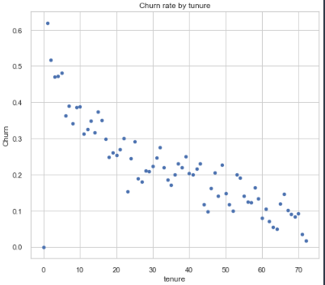
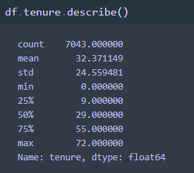
EDA – Numerical Variables
tenure
It shows that if the customer’s tenure is long then churn rate is low.

Slide 22
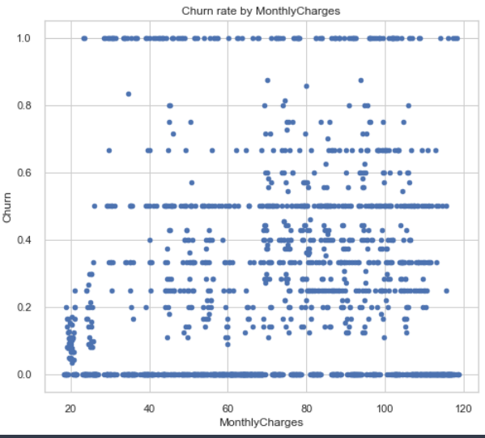
EDA –Numerical Variables
Monthly Charges
There seems to be no relation for Churn and MonthlyCharges.

Slide 23
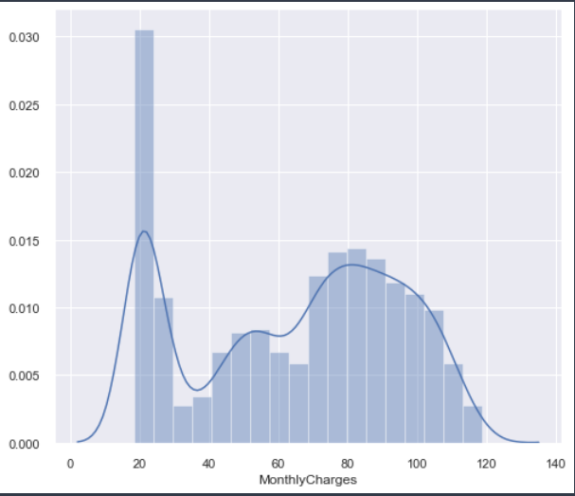
EDA – Numerical Variables
Monthly Charges
Monthly Charges seems to be roughly normal distribution.

Slide 24
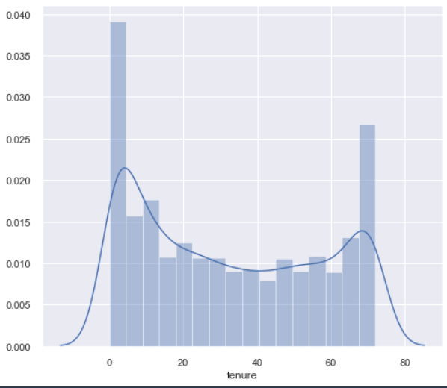
EDA – Numerical Variables
tenure
Tenure Distribution seems to be high at the tail ends, so a portion of the customers have either had lowest and highest tenure periods.

Slide 25
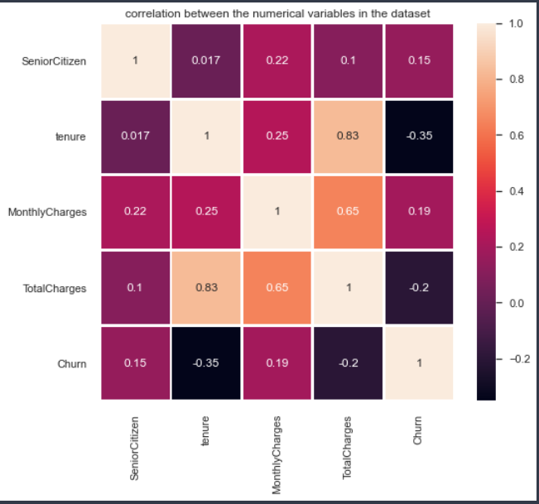
EDA – Numerical Variables
Correlations
Tenure is inversely correlated to Churn and then Monthly Charges are having positive correlation to Churn.

Slide 26
EDA Summary
More customers are using Fiber Optic for Internet Service have left the company than compared to DSL.
Customers who do not use online security have left the company.
Customers not using technical support have left the company.
Customers who pay month to month are the most who leave the company.
Customer's gender has almost equal rates of churn between them.
The Monthly Charges for customer's who churned tends to pay higher monthly fees than those that stay.
Customers that churn tend to be relatively new customers when looking at tenure distribution.

Slide 27
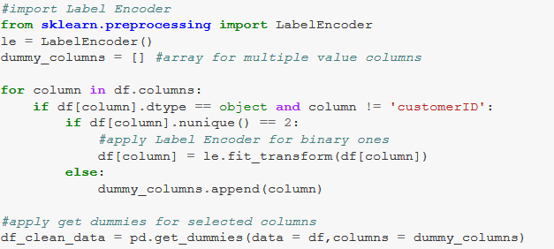
Data Pre-Processing
Categorical data label encoding
Machine learning works with only numerical values. Therefore, we need to convert our categorical values to numerical values. By using the Pandas function “get_dummies()”, we can replace the gender column with “gender_Female” and “gender_Male”. We will use df.info() to show us which ones are categorical and numerical.

Slide 28
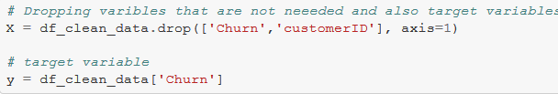
Data Pre-Processing
Dropping unwanted variables and target variable
In our dataset, we can see that customer ID is not needed for our model, so we drop the variable. We do not need to treat missing values as there are none in this dataset.

Slide 29

Test Train Split
Train on one set and test and measure on the test set.
Our model needs to be trained, second our model needs to be tested. Therefore it is best to have two different datasets.
Splitting the data 70% for training and 30% for testing.

Slide 30
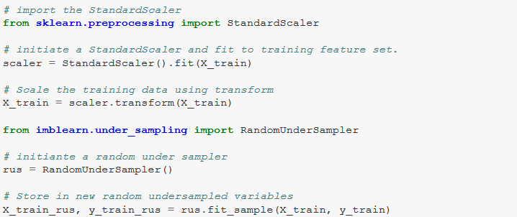
Handling Class Imbalance
Realized that the data set is facing a class imbalance so apply Under Sampling technique to standardized the dataset.

Slide 31
Machine Learning
The customer churn is a classification problem and have choose the following classification models to predict if a customer churns by fitting the training data set and testing on the test set. Used scikit-learn and other libraries in the python machine learning world.
1. Logistic Regression
2. Decision Tree model
3. Random Forest Classifier
4. Extreme gradient boosting (xGBoost)
Model performance metrics
Accuracy = Pct of correctly classified predictions (i.e, churn and non-churn)
Precision = Pct of total positive class predictions that were correctly classified
Recall = Pct of total positive class samples that were correctly classified

Slide 32
Machine Learning
For this customer churn problem, I have chosen the recall metric (sensitivity score) will suite the best as we want to reduce the number of false negatives (In reality the customer churned but the prediction is saying customer will not churn).
In this case it might be okay to have false positives as if a non-churning customer is classified and a churn customer, the company would not have incurred loss, while the opposite might come with a huge impact to the company and incur losses, so we will optimize for model with best recall metric.
Next, I have evaluated various machine learning models using the Cross-validation technique.

Slide 33
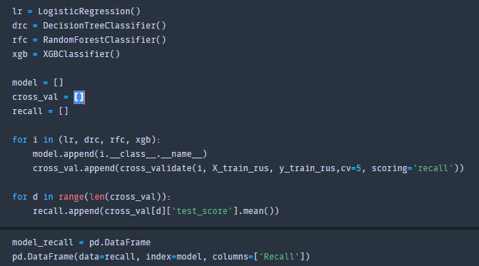
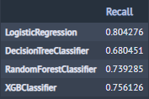
Cross Validation
In the most machine learning pipelines I have used the standard test train split and in this Cross validation method it splits the training features (X_train_rus) into 5 folds (I choose the default) there by using training data better to predict and score the models based on the recall classification metric we've chosen.
The Logistic Regression modelling seems to have a better recall compared to the next better modelling technique which is the xgBoost.

Slide 34
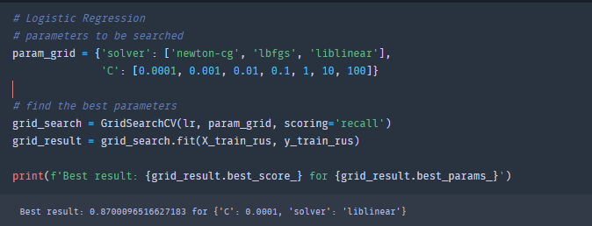
Hyper Parameter Tuning
After the evaluation of the model to select for evaluation, I have choose GridSearchCV to tune the hyper parameters
The Logistic Regression modelling seems to have a better recall compared to the next better modelling technique which is the xgBoost.

Slide 35
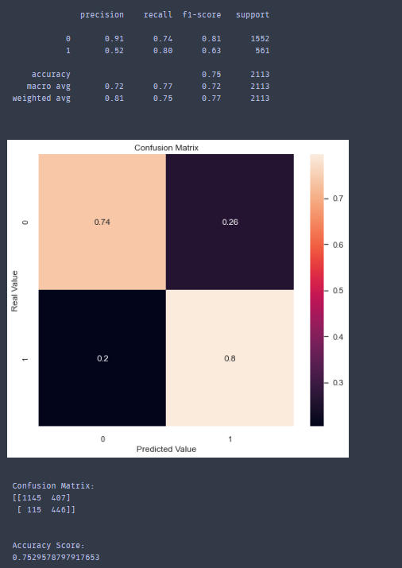
Logistic Regression
This type of statistical classification modelling is commonly used for predicting binary variables. It models the log odds of the probability of the target variable.
The accuracy train accuracy and the testing accuracy was around 80%
True positives (TP) - Predicted correctly that customer will churn - 446
True negative (TN) - Predicted correctly that customer would not churn - 1145
False positives (FP) - The model incorrectly predicted that they would churn when in reality they did not - 407
False negative (FN) - the model incorrectly predicted that customer will not churn when in reality they did churn - 115
The models seem to having maintaining recall rate between training and test models.

Slide 36
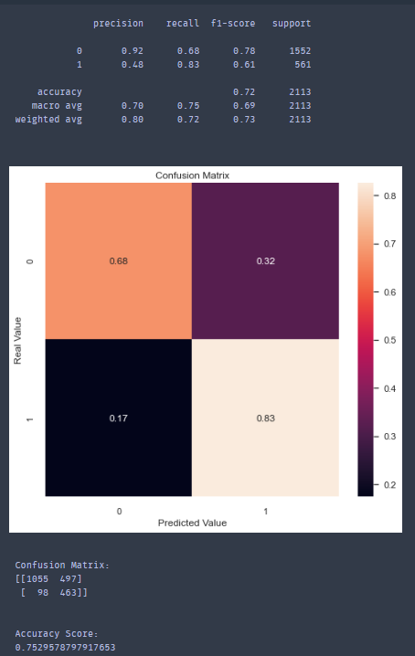
Decision Tree model
First tree-based model that splits the data multiple times based on the cutoff values defined in the features.
Model parameters: criterion = gini; max_depth=5;random_state=1
The accuracy train accuracy and the testing accuracy was around 79%
TP=1374
TN=303
FP=178
FN=258
The models seem to decent accuracy and precision and recall rates between train and test data set.

Slide 37
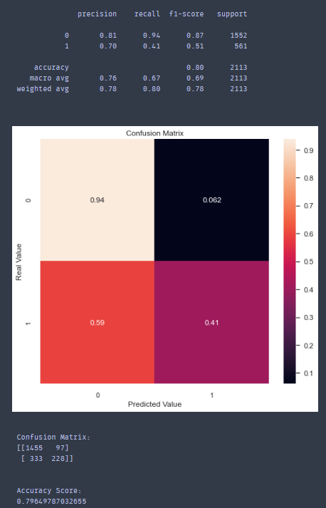
Random Forest
This is the second tree-based classification models we have experiments in the model phase. The difference between the previous model is it using bagging to define the boundaries in Random Forest models.
Model parameters include n_estimators=50; criterion=entropy’ min_samples_split=285
The accuracy train accuracy and the testing accuracy was around 79%
The models seem to have low recall rate and higher precession rate.
The model predicted more False Negatives compared to the previous Decision tree model.

Slide 38
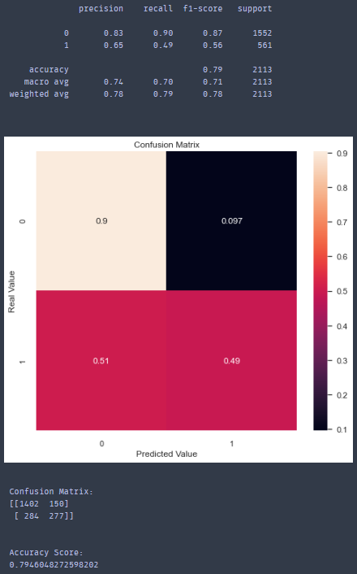
xGBoost (Extreme Gradient Boosting)
This is an open-source gradient boosted model which attempts to accurately predict target by combining the estimates of set of simpler, weaker models. This is a type of ensemble models.
The accuracy train accuracy and the testing accuracy was around 79%
The model prediction a lot of True negatives.
The models has low precision and recall scores compared to previous models.

Slide 39
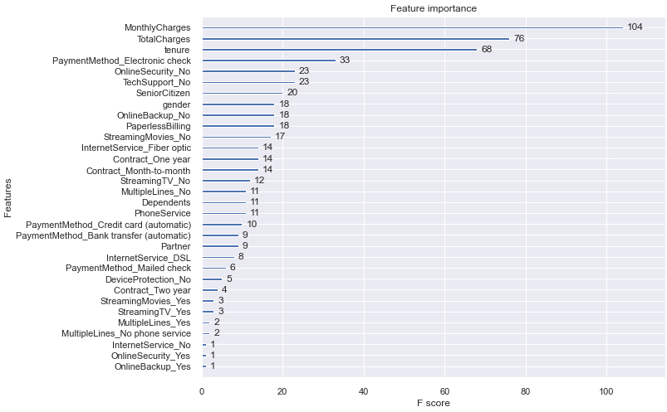
xGBoost (Extreme Gradient Boosting)

Slide 40
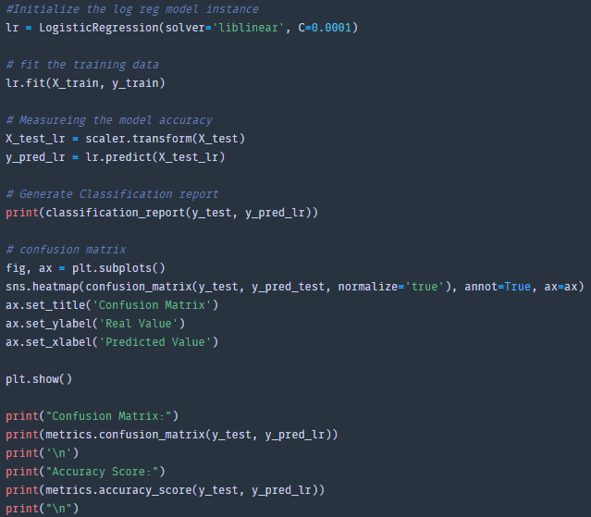
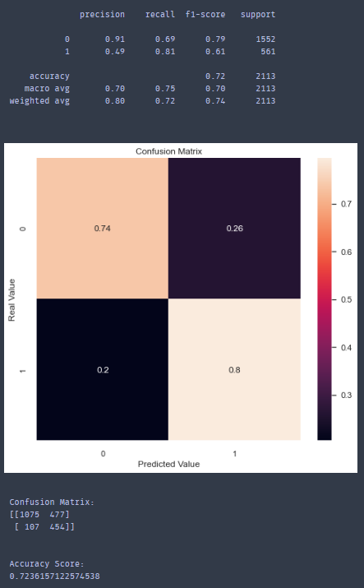
Final Model – Logistic Regression Tuned

Slide 41
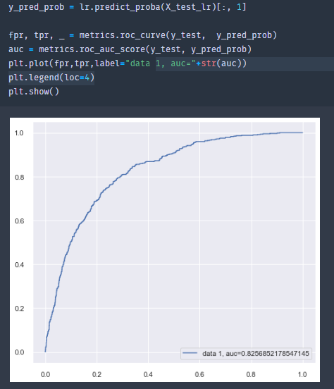
AUC Score

Slide 42
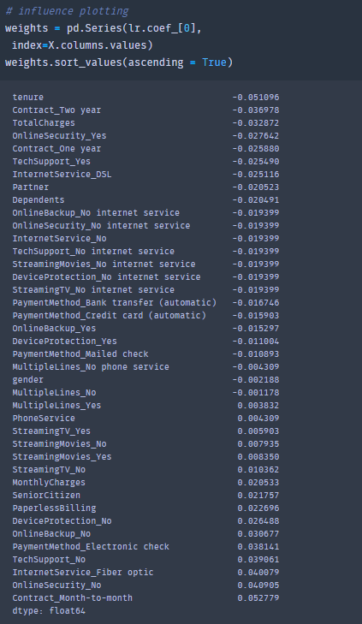
Influence Plot – Final Logistic Regression

Slide 43
Summary – Machine learning
The Logistic Regression model seems to be showing a balanced performance than compared to the other classification models we have experimented with.
After performing the cross validation on the different classification models that were selected, Logistic Regression model has the highest accuracy with recall and the decision criterion.
Used GridSearchCV to tune the hyper parameters for the Logistic Regression model.
After the final model is run and the influence plotting is completed to understand which features effected the churn most. It can be observed that tenure, Contract_two_year and TotalCharges are the top three feature that can effect customer churn.

Slide 44
Future steps
This project helped me in getting hands on experience with applying machine learning modelling for answering business questions such as the customer churn. By studying these customer churn probabilities can have various applications in company to better serve their customers.
If time would have permitted, I wanted to dig deeper into the xGBoost models hyper parameter tuning even though the recall metric was higher when used in the model. I believe fine tuning the parameter would result in a optimized xGBoost model.
Also, I would like to try new classification algorithms.

Slide 45
Questions?
Please Contact me

